Slide 1
3D Model Creation from Series of Images
Casey Conrad, Logan Hunter, Joanna Stecz

Slide 2
Intro to team and project
Casey Conrad
Logan Hunter
Joanna Stecz
Our project will take a series of images as input
Produce a 3D model of the space
Resulting model will be displayed in an interactive environment
Model and annotations can be saved to be opened in other modeling software

Slide 3
Initial promised deliverables
UML Diagrams and Documentation for the Project
The software application to produce 3D models from a series of images
Clustering images by subject to create single subject models
Structure from Motion and Linear Perspective to reintroduce depth
3D interactive environment to annotate and view the model
Encoding the model to a format that is commonly used in the target domains

Slide 4
Initial timeline
Milestone | Expected Completion Date
UML Diagram | 2/05/2022
Software to Group Images by Subject | 2/14/2022
Structure From Motion and Linear Perspective Algorithms for Single Subject Clusters | 2/28/2022
Software to remove nonconstant elements from images | 3/28/2022
Finalization of Backend | 3/28/2022
User Interface Elements | 4/14/2022
Finalization of Project | 4/18/2022

Slide 5
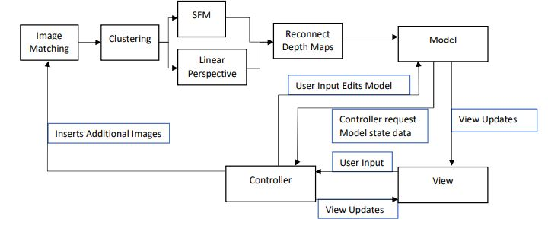
Timeline points achieved/ working on
Milestone 0 – UML Diagrams and Initial Design

Slide 6
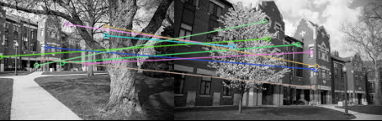
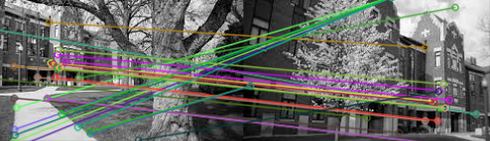
Timeline Points Achieved
Milestone 1 – Clustering Images based on Subject
Demo Software – Comparing KNN Matching to library Default and ORB to SIFT keypoint detection
Complete Version – Cluster Class and Program to load images into Clusters
ORB
SIFT

Slide 7
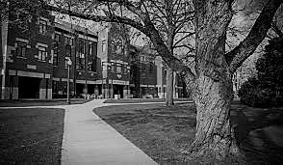
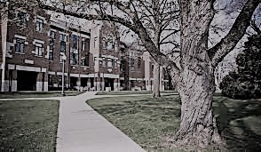
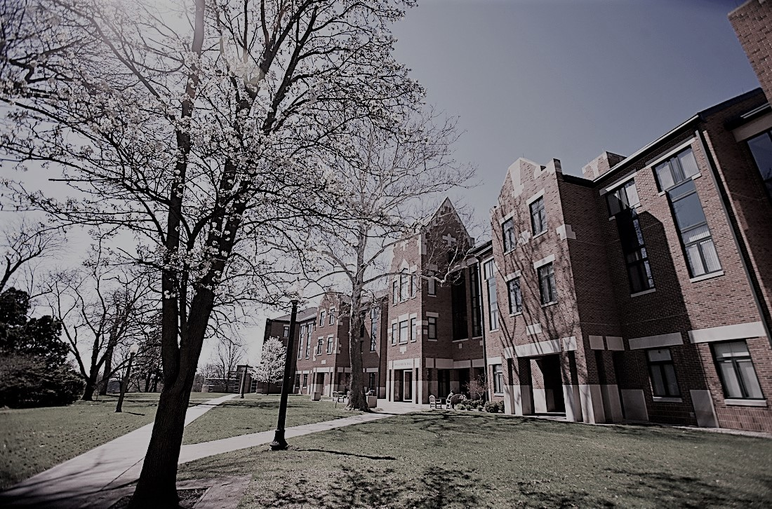
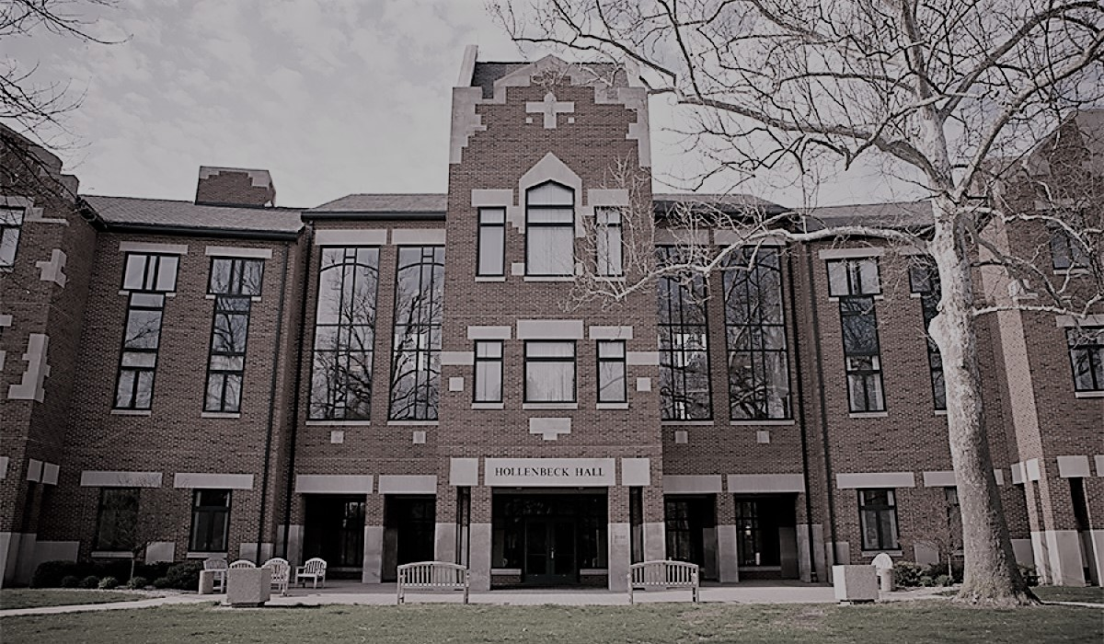
Current Milestone
Milestone 2 – Creation of Models
Structure from Motion
Graph of images based on keypoints
Linear Perspective
Utilizing the rigid geometry to determine vanishing points
Linear Perspective
Structure From Motion

Slide 8
Timeline/ Deliverable updates
Milestone 1 was completed a day after we intended, but it did not set us behind schedule
Removed some milestones that we realized were less important than we initially thought
Removing non-constant items like people and vehicles from images
Added in some more accurate milestones in their place
Stitching the models together

